Slide 1

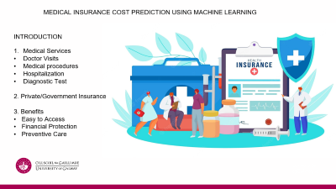


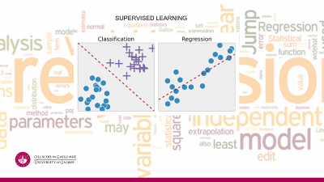
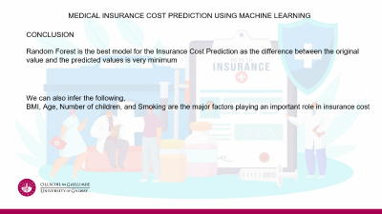
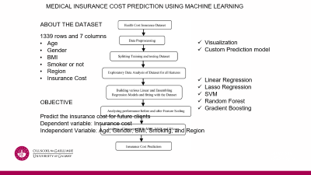
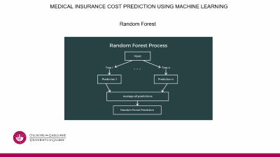


Slide 2


Slide 3

MEDICAL INSURANCE COST PREDICTION USING MACHINE LEARNING
INTRODUCTION
Medical Services
Doctor Visits
Medical procedures
Hospitalization
Diagnostic Test
2. Private/Government Insurance
3. Benefits
Easy to Access
Financial Protection
Preventive Care

Slide 4
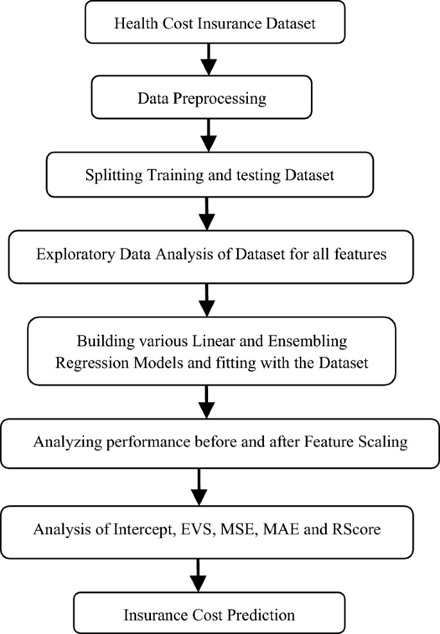
MEDICAL INSURANCE COST PREDICTION USING MACHINE LEARNING
ABOUT THE DATASET
1339 rows and 7 columns
Age
Gender
BMI
Smoker or not
Region
Insurance Cost
Visualization
Custom Prediction model
Linear Regression
Lasso Regression
SVM
Random Forest
Gradient Boosting
OBJECTIVE
Predict the insurance cost for future clients
Dependent variable: Insurance cost
Independent Variable: Age, Gender, BMI, Smoking, and Region

Slide 5
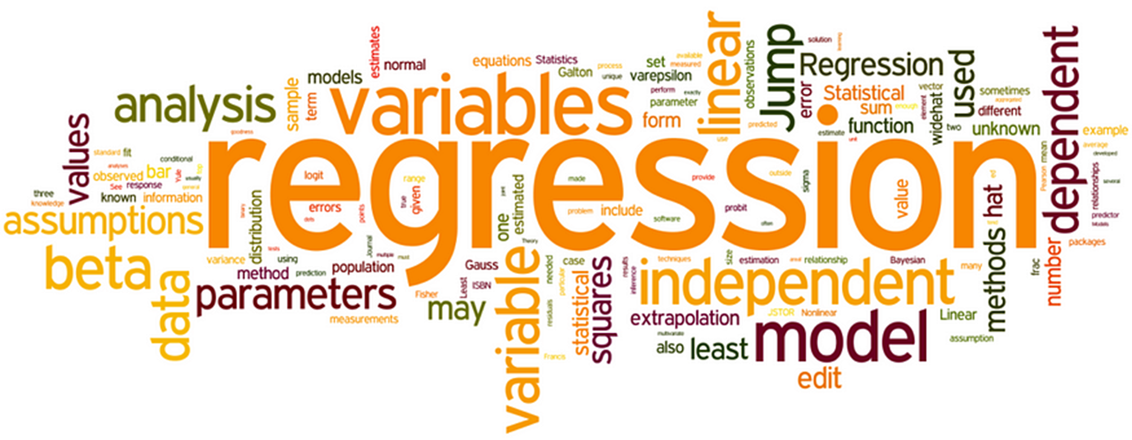

SUPERVISED LEARNING

Slide 6
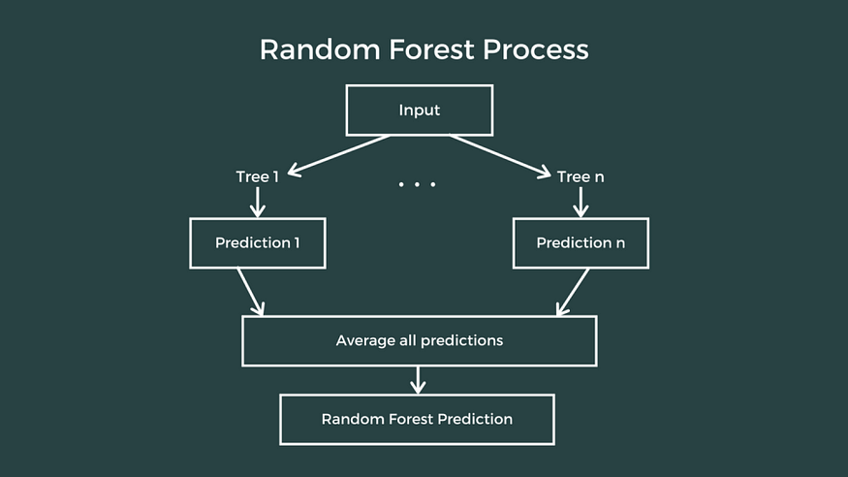
MEDICAL INSURANCE COST PREDICTION USING MACHINE LEARNING
Random Forest

Slide 7

MEDICAL INSURANCE COST PREDICTION USING MACHINE LEARNING
CONCLUSION
Random Forest is the best model for the Insurance Cost Prediction as the difference between the original value and the predicted values is very minimum
We can also infer the following,
BMI, Age, Number of children, and Smoking are the major factors playing an important role in insurance cost

Slide 8


